Slide 1

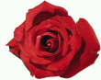
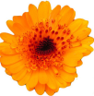
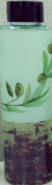

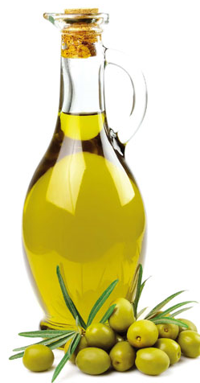
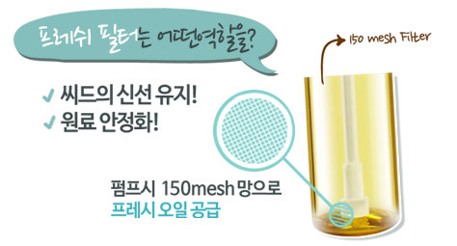
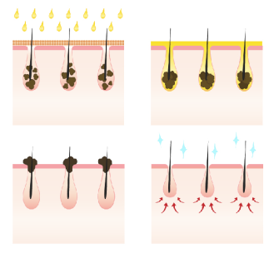
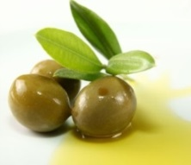
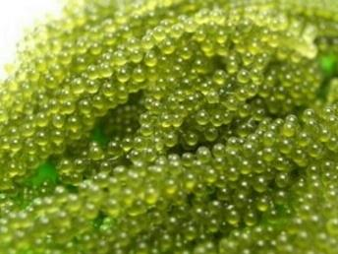



2 types of Marseille Olive Cleansing Oil
NEW! Marseille Olive Cleansing Line
★ We are the first in many Brand shops
Formulated with Premium Extra Virgin Olive from France
Purifying Cleansing like Magic!
Real Flower Petal Cleansing Oil
Now You can look and feel the real petal
Real Rose Petal & Calendula Petal
in Cleansing Oil.
100% Extra version Olive oil
Real rose petal and calendula petal contained
Patented Hydrating agent, ‘PTMA Oligomer’
(Anti-aging)
Free of 6 (No Paraben, mineral oil, animal oil, benzophenon, talc, sodium Lauryl Sulphate.
“Real rose !”
“Real Caleudula!”
Fresh Filter Used
to keep ingredients more effective and stable.
Deep Cleansing
Natural oil deeply cleanses makeup, pollutants and blackheads.
Common Ingredients of Marseille Olive Cleansing
There is 150 mesh filter right below the pump tube, letting the fresh oil every time you pump out.!
Eco-cert Certified.
100% Extra Version oil from France Marseille (Premium quality)
France Marseille Region is known for high quality olive oil production. Their product has ultra high antioxidant power and excellent for skin nourishment. Its high vitamin E and C contents delays aging process, promotes firming and prevents wrinkle formation. It also has blackhead removing properties. Therefore skin is thoroughly cleaned without dry after feel.
Marseille Olive Cleansing Product Lineup
Name | Texture | Vol | Price
Marseille Olive Cleansing Oil <Rich Purifying> | Thicker Texture (With Real Rose Petal) | 140ml | 16,000 won
Marseille Olive Cleansing Oil <Fresh Purifying> | Thinner Texture (With Real Calendula petal) | 140ml | 16,000 won
Marseille Olive Cleansing Oil Tissue | Thick tissue soaked with oil | 40pc | 6,000 won
Marseille Olive Waterproof Lip & Eye Remover | Liquid Emulsion with dual layer | 150ml | 9,000 won
Marseille Olive Cleansing Foam | Gummy textured foam | 150ml | 8,000 won
Special Hydrating Ingredient, ‘ PTMA Oligomer!
Extracted from Sea Grape, which is called as ‘Green Caviar.’
Packed with various mineral, vitamins and fibers, PTMA Oligomer clarifies skin tone, prevents free radical damage and discharges waste from the skin. The mucus in its grains retains high amount of moisture and shows amazing ability to heal and renew damaged cell.
Complexion enhancing
Rosemary Extract
Great nourishment
Honey Extract
Skin STrengthening
Papaya Extract

Slide 2

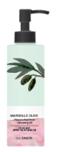
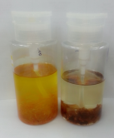
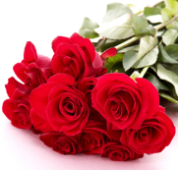



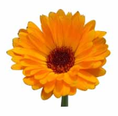
Marseille Olive Cleansing Product
size/price: 40pc / 6,000 won | Name | Marseille Olive Cleansing Oil Tissue <Perfect & enriched>
 | Concept | Very soft and hydrating Oil cleansing tissue
 | Target | Those who were looking for non-drying tissue. Those looking for Mild plant-based cleansing tissue
Features | Non-drying tissue with more nourishing texture. High quality, gentle fabric used. Strong cleansing power. Waterproof makeup can easily be removed.
Sales Talk | Even the very last tissue is soaked with the contents. Fabric and the ingredients are gentle on your skin. Thick 53g tissue can retain high amount of the contents and remove even the heaviest makeup including the waterproof makeup. You’ll love our convenient and high performing Cleansing oil tissue.
size/price : 140ml / 16,000원 | Name | Marseille Olive Cleansing Oil <Rich Purifying>
 | Concept | Real Rose Cleansing oil!
 | Target | Dehydrated, Dry skin type Customer looking for a mild formula cleansing oil.
Features
Sales Talk | The Real Flower petal containing cleansing oil is now available in the Saem. We could only find those items in the premium brands. The rose is in more fresh form, giving you higher amount of the nutrients.
★For Dry skin
<You Can See the Real Rose Petal!>
Thick texture suitable for thin, easily irritated, dehydrated skin. Safe rolling.
Washable oil . No need to use tissue.
Real Rose Petal!
Rose is rich with vitamin C, A and Estrogen. Great for anti-bacterial, anti-allergy and Anti-oxidation.
size/price: 150ml/ 9,000won | Name | Marseille Olive Waterproof Lip & Eye Remover <Safe & Mild>
 | Concept | Gentle formulation of dual layered lip & eye makeup remover.
 | Target | Customer looking for powerful color makeup cleanser. Mild formula users.
Features | Hydration and Cleansing at the same time. Dual layer of Cream+ Toner Super easy and fast makeup remover.
Sales Talk | Isn’t it hard to clean the eye makeup completely without a residue? We have a gentle but super easy eye makeup remover made with high quality olive oil.
size/price: 140ml / 16,000원 | Name | Marseille Olive Cleansing Oil <Fresh Purifying>
 | Concept | Real Calendula Cleansing Oil !
 | Target | Customer who prefers fresh type oil. Oily skin type Customer looking for a mild formula cleansing oil.
Features
Sales Talk | Do you see the calendula petal here? We’re the first brand shop making the real flower petal containing oil. This oil is suitable for those with oilier skin. It doesn’t feel too greasy. It easily removes makeup and even melts the blackheads for easy removal. Your skin will feel cleanser and softer.
★For Oily Skin
size/price: 150ml/ 8,000won | Name | Marseille Olive Cleansing Foam <Moisture & Rich>
 | Concept | Gummy textured Moisture cleansing foam
 | Target | Ultra Hydrating Cleansing foam Customer looking for a Mild formula
Features | Gummy textured foam forms abundant and dense foam for easy cleansing. No dry after-feel even after cleansing.
Sales Talk | Your skin always feel tight after the cleansing? Try our new Marseille Olive Cleansing Foam. Its tiny particle size goes deeper into the skin and takes out all the dirt and makeup residue. It contains Special hydrating agents as well as the extra version olive oil , leaving skin soft and comfortable after washing.
< You Can See the Real Calendula Petal!>
Less greasy, fresher textured oil suitable for enlarged pores and oily skin types.
Washable oil . No need to use tissue.
★ Real Calendula Petal!
Calendula is known for its healing, bacteria-killing properties.
It also helps ease the troubles and excess oiliness.

